Slide 1
An evaluation of hospital catchment area algorithms in Ho Chi Minh City Vietnam

Slide 2
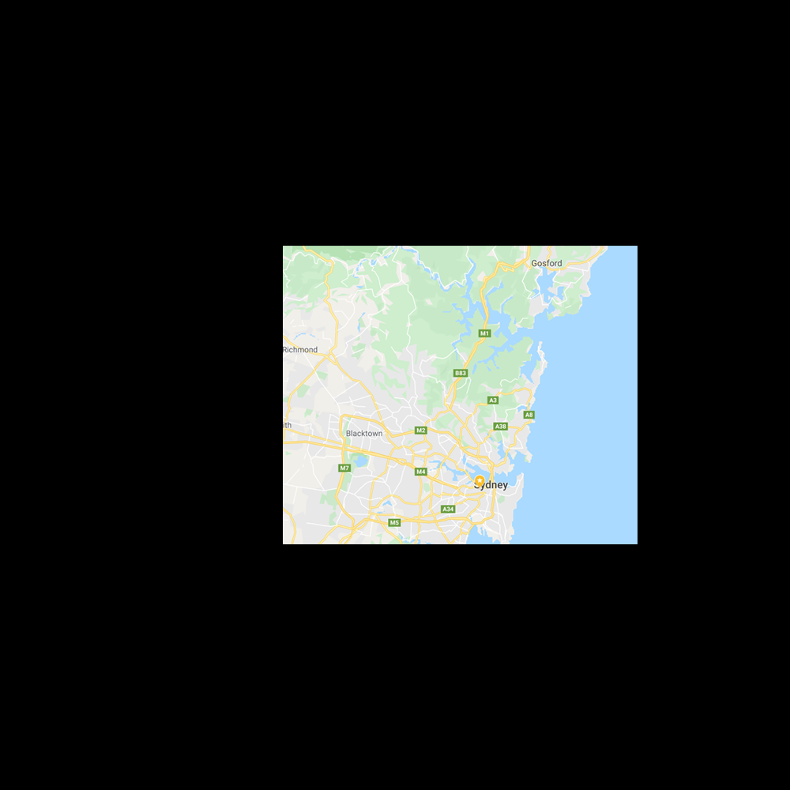
Background
The hospital catchment area problem
Consider a map of Sydney
Sydney has a series of local health districts which are serviced by major tertiary hospitals
For example, The WSLHD is serviced by the tertiary hospitals of Westmead and Blacktown/Mt Druitt

Slide 3
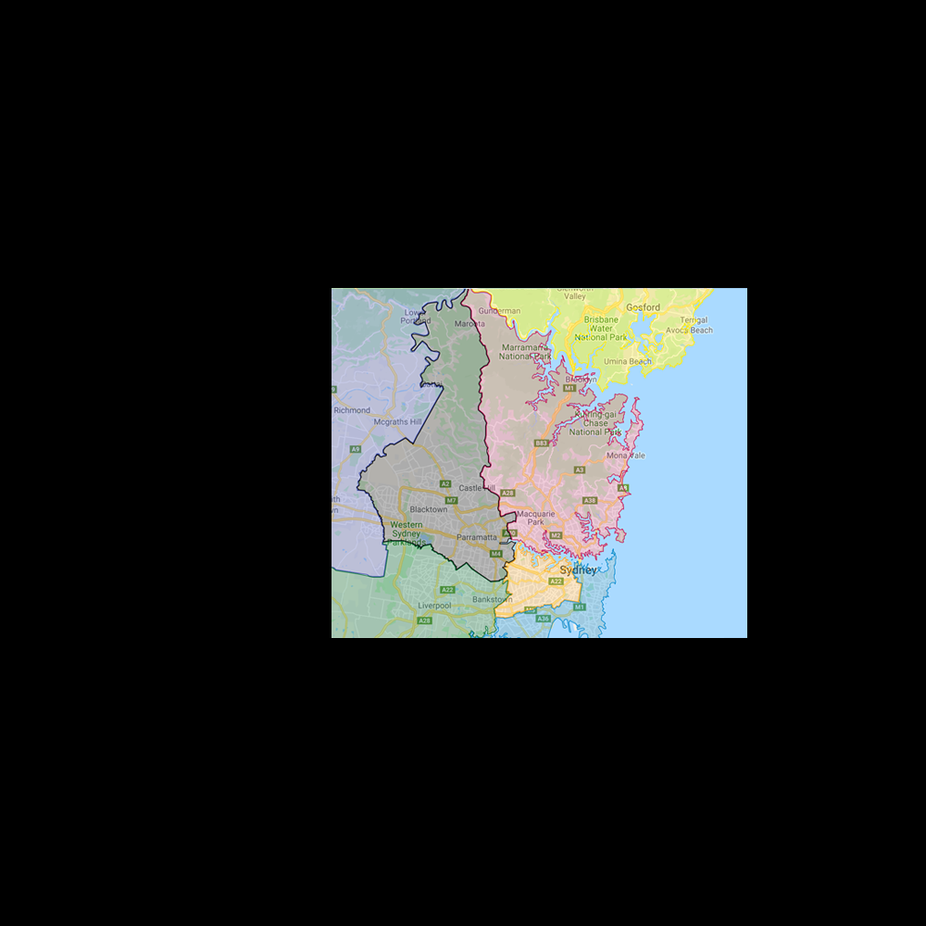
Background
The hospital catchment area problem
The region which is referred to Westmead Hospital is the catchment area of this hospital
It is the ‘patient source’ for this hospital

Slide 4
Background
The hospital catchment area problem
Why is this useful to know?
Westmead has a better understanding of its main demographic
From these risk factors, they can spend more money on the more common therapies
Hospitals more rural (e.g. Nepean) may require arrangement of shuttle transport or other services to help their patients
Important for identification of study bases in cross-sectional, cohort and case-control studies (e.g. CHAMP study in Concord)

Slide 5
Background
The hospital catchment area problem
What is a catchment area?
No agreed upon model definition!
Patient-independent approach
Fixed radius method [1, 2]
Network analysis fixed time method [3]
Patient dependent approach
Variable radius method [4]
Marginal rules:
Maximum-marginal +/- Fill-in [5, 6]
Maximum-marginal + Fill-in + cumulative case ratio [7]
Straight marginal [5]
Minimum marginal [5]
And we don’t know which one is the best either
1. Luft, H.S. and S.C. Maerki, COMPETITIVE POTENTIAL OF HOSPITALS AND THEIR NEIGHBORS. Contemporary Economic Policy, 1984. 3(2): p. 89-102. 2.Diesfeld, H.J., The Definition of the Hospital Catchment Area and its Population as a Denominator for the Evaluation of Hospital Returns in Developing Countries*†. International Journal of Epidemiology, 1973. 2(1): p. 47-53. 3.Schuurman, N., et al., Defining rational hospital catchments for non-urban areas based on travel-time. International Journal of Health Geographics, 2006. 5(1): p. 43. 4. Phibbs, C.S. and J.C. Robinson, A variable-radius measure of local hospital market structure. Health services research, 1993. 28(3): p. 313-324 5. Zwanziger, J., G.A. Melnick, and J.M. Mann, Measures of hospital market structure: a review of the alternatives and a proposed approach. Socio-Economic Planning Sciences, 1990. 24(2): p. 81-95. 6. Alexandrescu, R., et al., A proposed approach in defining population-based rates of major injury from a trauma registry dataset: Delineation of hospital catchment areas (I). BMC Health Services Research, 2008. 8(1) 7. Zinszer, K., et al., Determining health-care facility catchment areas in Uganda using data on malaria-related visits. Bulletin of the World Health Organization, 2014. 92(3): p. 178-186

Slide 6
Background
The hospital catchment area problem
What is a catchment area?
No agreed upon model definition!
Patient-independent approach
Fixed radius method [1, 2]
Network analysis fixed time method [3]
Patient dependent approach
Variable radius method [4]
Marginal rules:
Maximum-marginal +/- Fill-in [5, 6]
Maximum-marginal + Fill-in + cumulative case ratio [7]
Straight marginal [5]
Minimum marginal [5]
And we don’t know which one is the best either
Aim 1: Evaluate the catchment area models for greatest accuracy
1. Luft, H.S. and S.C. Maerki, COMPETITIVE POTENTIAL OF HOSPITALS AND THEIR NEIGHBORS. Contemporary Economic Policy, 1984. 3(2): p. 89-102. 2.Diesfeld, H.J., The Definition of the Hospital Catchment Area and its Population as a Denominator for the Evaluation of Hospital Returns in Developing Countries*†. International Journal of Epidemiology, 1973. 2(1): p. 47-53. 3.Schuurman, N., et al., Defining rational hospital catchments for non-urban areas based on travel-time. International Journal of Health Geographics, 2006. 5(1): p. 43. 4. Phibbs, C.S. and J.C. Robinson, A variable-radius measure of local hospital market structure. Health services research, 1993. 28(3): p. 313-324 5. Zwanziger, J., G.A. Melnick, and J.M. Mann, Measures of hospital market structure: a review of the alternatives and a proposed approach. Socio-Economic Planning Sciences, 1990. 24(2): p. 81-95. 6. Alexandrescu, R., et al., A proposed approach in defining population-based rates of major injury from a trauma registry dataset: Delineation of hospital catchment areas (I). BMC Health Services Research, 2008. 8(1) 7. Zinszer, K., et al., Determining health-care facility catchment areas in Uganda using data on malaria-related visits. Bulletin of the World Health Organization, 2014. 92(3): p. 178-186

Slide 7
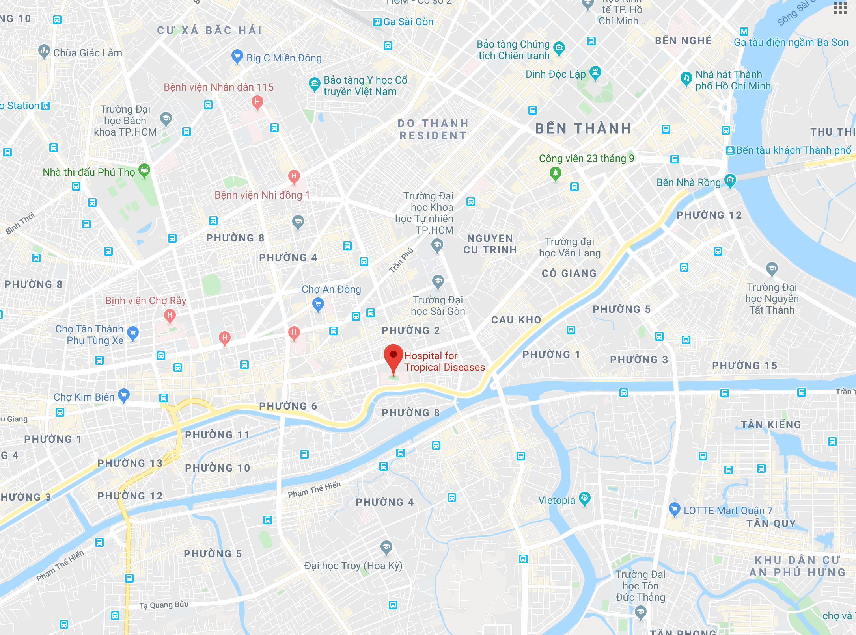


Background
[1, 2]
[1, 2]
[1, 2]
The hospital catchment area problem: (1) Patient-independent approaches
Patient-independent approaches are simple
Fixed radius method

Slide 8






Background
[1, 2]
[1, 2]
[1, 2]
The hospital catchment area problem: (1) Patient-independent approaches
Patient-independent approaches are simple
Fixed radius method
Network analysis method
These methods are old and do not require patient data

Slide 9
Background
The hospital catchment area problem: (2) Patient dependent approaches
Patient data must be available and plotted
This is a ‘data-based’ approach

Slide 10





Background
[1, 2]
[1, 2]
[1, 2]
The hospital catchment area problem: (2) Patient dependent approaches
Patient data must be available and plotted
This is a ‘data-based’ approach
Variable radius

Slide 11











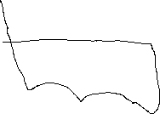













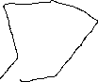
Background
[1, 2]
[1, 2]
[1, 2]
The hospital catchment area problem: (2) Patient dependent approaches
Patient data must be available and plotted
This is a ‘data-based’ approach
Variable radius
Marginal approaches (based on ‘regions’)

Slide 12









Background
[1, 2]
[1, 2]
[1, 2]
The hospital catchment area problem: (2) Patient dependent approaches
Patient data must be available and plotted
This is a ‘data-based’ approach
Variable radius
Marginal approaches (based on ‘regions’)

Slide 13

Background
[1, 2]
[1, 2]
[1, 2]
The hospital catchment area problem: (2) Patient dependent approaches
Patient data must be available and plotted
This is a ‘data-based’ approach
Variable radius
Marginal approaches (based on ‘regions’)
Marginal + Fill-in methods

Slide 14
Background
[1, 2]
[1, 2]
[1, 2]
The hospital catchment area problem: (2) Patient dependent approaches
Patient data must be available and plotted
This is a ‘data-based’ approach
Variable radius
Marginal approaches (based on ‘regions’)
Marginal + Fill-in methods
Slight nuances exist between the various Marginal or ‘patient-flow’ approaches, however they are largely similar

Slide 15
Background
[1, 2]
[1, 2]
[1, 2]
The hospital catchment area problem: (2) Patient dependent approaches
Patient data must be available and plotted
This is a ‘data-based’ approach
Variable radius
Marginal approaches (based on ‘regions’)
Marginal + Fill-in methods
Slight nuances exist between the various Marginal or ‘patient-flow’ approaches, however they are largely similar

Slide 16
Background
[1, 2]
[1, 2]
[1, 2]
Data plotting problem
Patient data must be available and plotted
Patient addresses → WGS84 Latitudes and Longitudes
Lat + Longs → plot on the map

Slide 17
Background
[1, 2]
[1, 2]
[1, 2]
Data plotting problem
Patient data must be available and plotted
Patient addresses → WGS84 Latitudes and Longitudes Actually…
Patient addresses → Interpret the address (‘Fuzzy-matching’)
Interpreted address → WGS84 Lat + Long (‘Geocoding’)
Lat + Longs → plot on the map

Slide 18
Background and Rationale
[1, 2]
[1, 2]
[1, 2]
FUZZY-MATCHING problem
Bad data in = bad information out
Patients can mis-spell their addresses
Patient may not where the administrative boundaries are and write the wrong ‘suburb’ (Ward)
Patients may have messy writing and be typed into the system wrong
Etc…
Fuzzy-matching matches ‘provided’ address with a database to find the ‘predicted’ address

Slide 19
Background and Rationale
[1, 2]
[1, 2]
[1, 2]
FUZZY-MATCHING problem
Fuzzy-matching matches ‘provided’ address with a database to find the ‘predicted’ address
... Which algorithm do we use?
Google maps
Bing maps
MapQuest
Tom Tom
HERE maps
Melissa DATA
ArcGIS

Slide 20
Background and Rationale
[1, 2]
[1, 2]
[1, 2]
FUZZY-MATCHING problem
Fuzzy-matching matches ‘provided’ address with a database to find the ‘predicted’ address
... Which algorithm do we use?
Google maps
Bing maps
MapQuest
Tom Tom
HERE maps
Melissa DATA
ArcGIS
Aim 2: Evaluate the effectiveness and accuracy of fuzzy-matching algorithm services
Issue 1: Google, MapQuest, Tom Tom, HERE require paid services to analyse the address data after a free trial
Issue 2: Melissa DATA and ArcGIS are completely paid services
Issue 3: As I cannot read Vietnamese, I cannot determine the accuracy of the fuzzy-matching algorithms

Slide 21
Background and Rationale
[1, 2]
[1, 2]
[1, 2]
GEOCODING problem
Geocoding converts address data into Lat + Long data (to plot)
… which services do we use?
Google maps
Bing maps
MapQuest
Tom Tom
HERE maps
Melissa DATA
ArcGIS
OpenStreetMaps (Nominatim)
Aim 3: Evaluate the effectiveness and accuracy of geocoding services
Issue 4: Some services are linked between fuzzy-matching and geocoding, meaning parsing formatted address data through a geocoder will result in a second round of fuzzy-matching – we cannot inherently separate

Slide 22
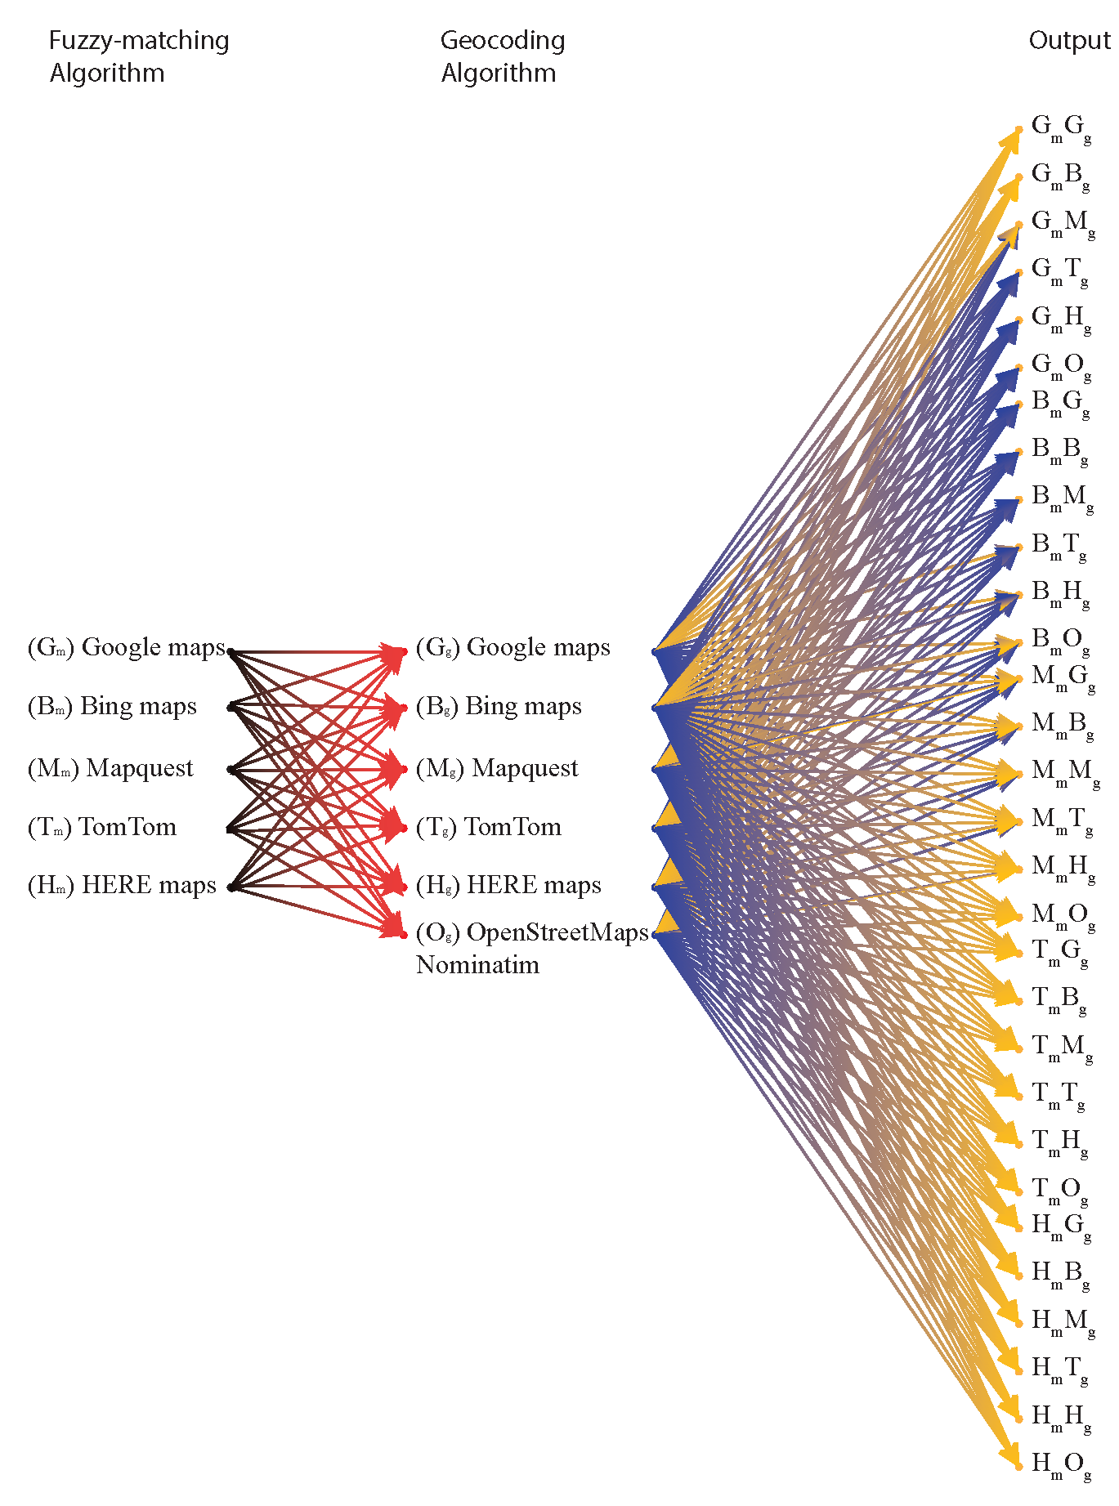
Background and Rationale
[1, 2]
[1, 2]
[1, 2]
Workflow
Aim 4: Propose a pipeline for efficient and effective geocoding of Vietnamese hospital data

Slide 23
Aims
Evaluate the available catchment area models for greatest accuracy with provided hospital data
Evaluate the effectiveness and accuracy of fuzzy-matching algorithm services
Aim 3: Evaluate the effectiveness and accuracy of geocoding services
Aim 4: Propose a pipeline for efficient and effective geocoding of Vietnamese hospital data

Slide 24
Summary of progress
Completed a miniature review of literature to determine most common geocoding systems available
Python implementation of database rearrangement, Fuzzy-matching and geocoding algorithms using:
Google geocoding API, Bing Maps REST API, MapQuest (Version) geocoding API, OpenStreetMaps (OSM) Nominatim and MapQuest OPEN geocoding API (both implementations of OSM), HERE Geocoding API, TomTom Geocoding API (‘datasetgeocode’ library).
Complete fuzzy-matching and geocoding of HCMC datasets using Google Maps, Bing Maps and OSM APIs.
Data plotting of longitude/latitudinal coordinates in QGIS software
Python implementation of Network analysis / distance matrix / Route Finding APIs – currently only completed for Google Maps API and Bing REST API
All scripts currently available at: https://github.com/weberliuMD/Hospital-Catchment-Area-Tools-H-CAT

Slide 25
Future direction
Date estimate | Achievement goal
November 25 | Complete implementation of network analysis algorithms
December 5 | Complete geocoding and fuzzy matching for all HTD and PNT datasets
December 15 | Complete evaluation of geocoding and fuzzy-matching efficacy
December 18 | Complete Python-based scripts for catchment-area modelling, with use of PyQT and QGIS-python for automated map generation
January 5 | Complete evaluation of accuracy of catchment area models for hospital admissions data

